Slide 1

Algorithms and Data Structures 2 CS 1501
Fall 2021
Sherif Khattab
ksm73@pitt.edu
(Slides are adapted from Dr. Ramirez’s and Dr. Farnan’s CS1501 slides.)

Slide 2
Announcements
Upcoming deadlines:
Lab 11: Friday 12/10
Lab 12 and Homework 12: Monday 12/20 at 5:00 pm
Assignment 4 and 5: Monday 12/20 at 5:00 pm
Final Exam
In-person, paper-based, 110 minutes
Similar structure to the midterm
Non-cumulative
Study guide and practice exams
Date, time, and location as in PeopleSoft
Review session next week
Remote (over Zoom) and recorded
(day and time TBD)
Bonus Opportunities
Bonus Homework: Monday 12/20 at 5:00 pm
OMETs: 1 bonus point for entire class when response rate >= 80%
Currently at 36-38%
Deadline is this Sunday

Slide 3
Previous lecture …
(Big) Integer Algorithms
Exponentiation
Cryptography
One-time pads
RSA

Slide 4
CourseMIRROR Reflections
Post-survey will be emailed to you

Slide 5
CourseMIRROR Reflections (11 am)
Most Interesting
Encryption
One-time pads
Public key
RSA
Master theorem explanation
Most Confusing
The problem with randomness
Another run through of the runtime analyses from class would be helpful
RSA key

Slide 6
CourseMIRROR Reflections (3 pm)
Most Interesting
RSA encryption
One-time pad
Shannon’s entropy reappears in encryption. Can we not just use some compression scheme as an encryption tool?
Most Confusing
Exponentiation algorithm run time analysis
How are RSA keypad public and private keys selected?
- Why did we make a long explanation for the 5-line exponentiation algorithm? Isn’t it given that the process of exponentiation runs in… exponential time ? Can we review the explanation

Slide 7
Today …
RSA (contd.)
Greedy Algorithms
Dynamic Programming

Slide 8
n, e, and d need to be carefully generated
Choose two prime numbers p and q
Compute n = p * q
Compute φ(n)
φ(n) = φ(p) * φ(q) = (p - 1) * (q - 1)
Choose e such that
1 < e < φ(n)
GCD(e, φ(n)) = 1
I.e., e and φ(n) are co-prime
Determine d as d = e⁻¹ mod(φ(n))

Slide 9
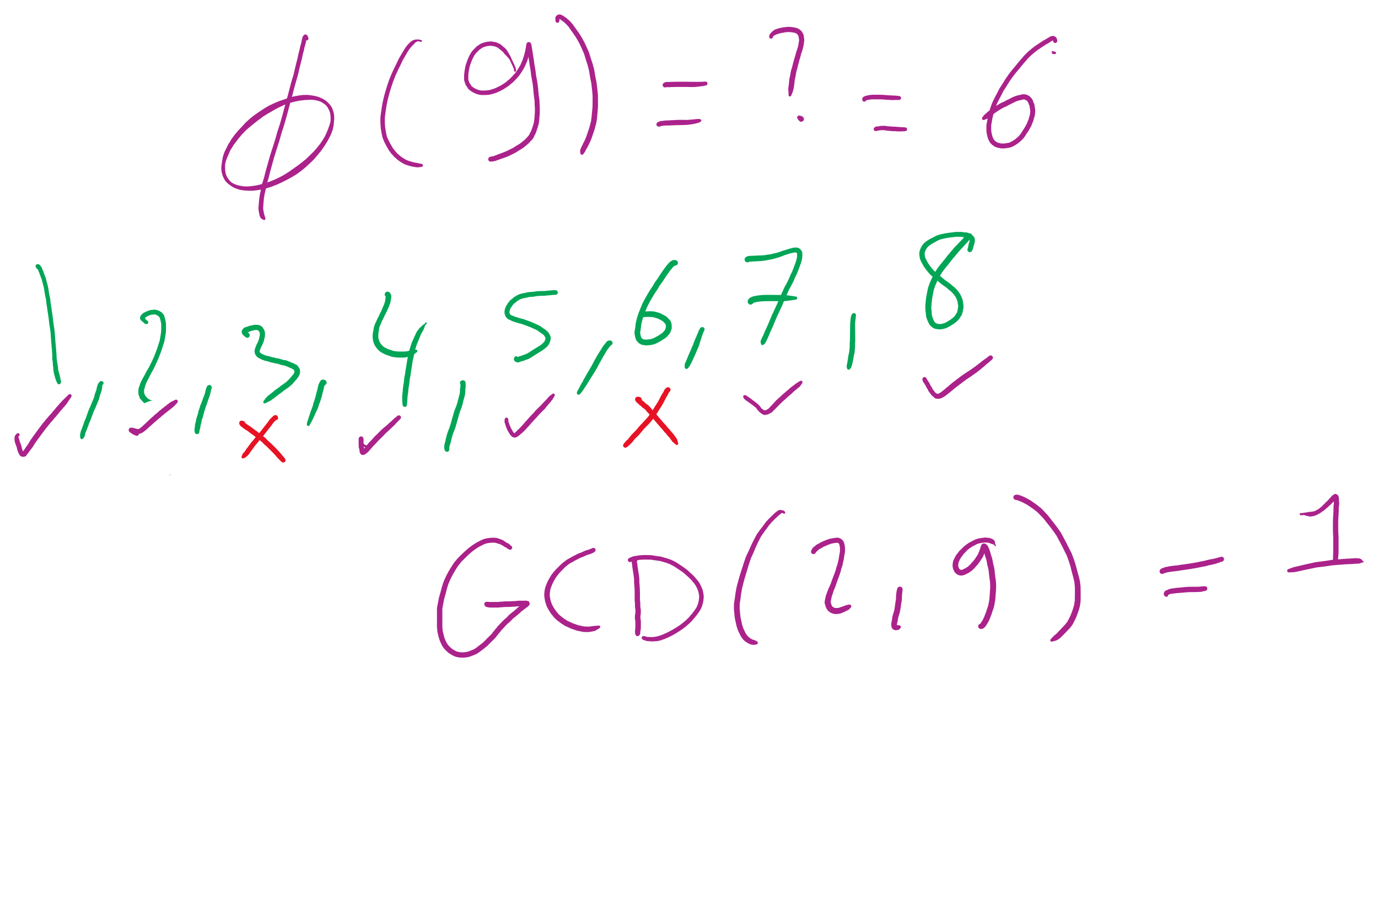
What is φ?
Here, we mean φ to be Euler’s totient
φ(n) is a count of the integers < n that are co-prime to n
I.e., how many k are there such that:
1 <= k <= n AND GCD(n, k) = 1
p and q are prime..
Hence, φ(p) = p - 1 and φ(q) = q -1
Further, φ is multiplicative
Since p and q are prime, they are co-prime, so
φ(p) * φ(q) = φ(p * q) = φ(n)
I won’t detail the proof here...

Slide 10
Greatest Common Divisor (GCD)
Given two numbers a and b find their greatest common divisor
e.g., GCD(1501, 57) is 19
Euclid’s (c. 300 BC) algorithm is linear!
GCD(a,b) = GCD(b, a%b)
GCD(a, 0) = a
Linear time means Theta(log n)
each integer is n bits

Slide 11
eXtended Greatest Common Divisor (XGCD)
Given two numbers a and b find two integers x and y such that
GCD(a,b) = x*a + y*b
e.g., XGCD(1501, 57) is (1, -26) because
GCD(1501, 57) = 19 = 1*1501 + -26* 57
This can also be computed in linear time

Slide 12
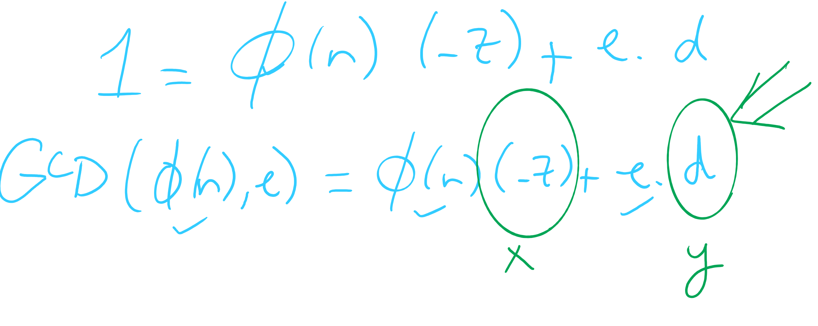
OK, now what about multiplicative inverses mod φ(n)?
d = e⁻¹ mod(φ(n))
Means that d = 1/e mod(φ(n))
Means that e * d = 1 (mod φ(n))
Now, this can be equivalently stated as e * d = z * φ(n) + 1
For some z
Can further restate this as: e * d - z * φ(n) = 1
Or similarly: 1 = φ(n) * (-z) + e * d
How can we solve this?
Hint: recall that we know GCD(φ(n), e) = 1

Slide 13
Use extended Euclidean algorithm!
GCD(a, b) = i = ax + by
Let:
a = φ(n)
b = e
x = -z
y = d
i = 1
GCD(φ(n), e) = 1 = φ(n) * (-z) + e * d
We can compute d in linear time!

Slide 14
RSA keypair example notes
p and q must be prime
n = p * q
φ(n) = (p - 1) * (q - 1)
Choose e such that
1 < e < φ(n) and GCD(e, φ(n)) = 1
Solve XGCD(φ(n), e) = 1 = φ(n) * (-z) + e * d
Compute the ciphertext c as:
c = m^{e} (mod n)
Recover m as:
m = c^{d} (mod n)
Notes:
Ready (( … )**13) % 77 in a python prompt
Advertise public key (n=77, e=37)
Request an encrypted message
What does the mod n mean for possible messages to encrypt??
Show result
Step through key gen process
p = 7, q = 11
n = 77
φ(n) = 60
select e to be 37
co-prime to 60
XGCD(60, 37) = 1 = 60 * -8 + 37 * 13
d = 13

Slide 15
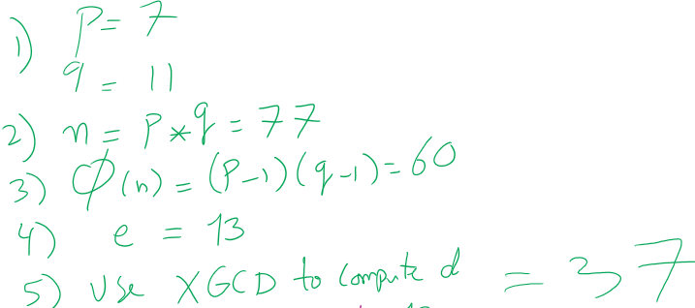
RSA Example 1

Slide 16
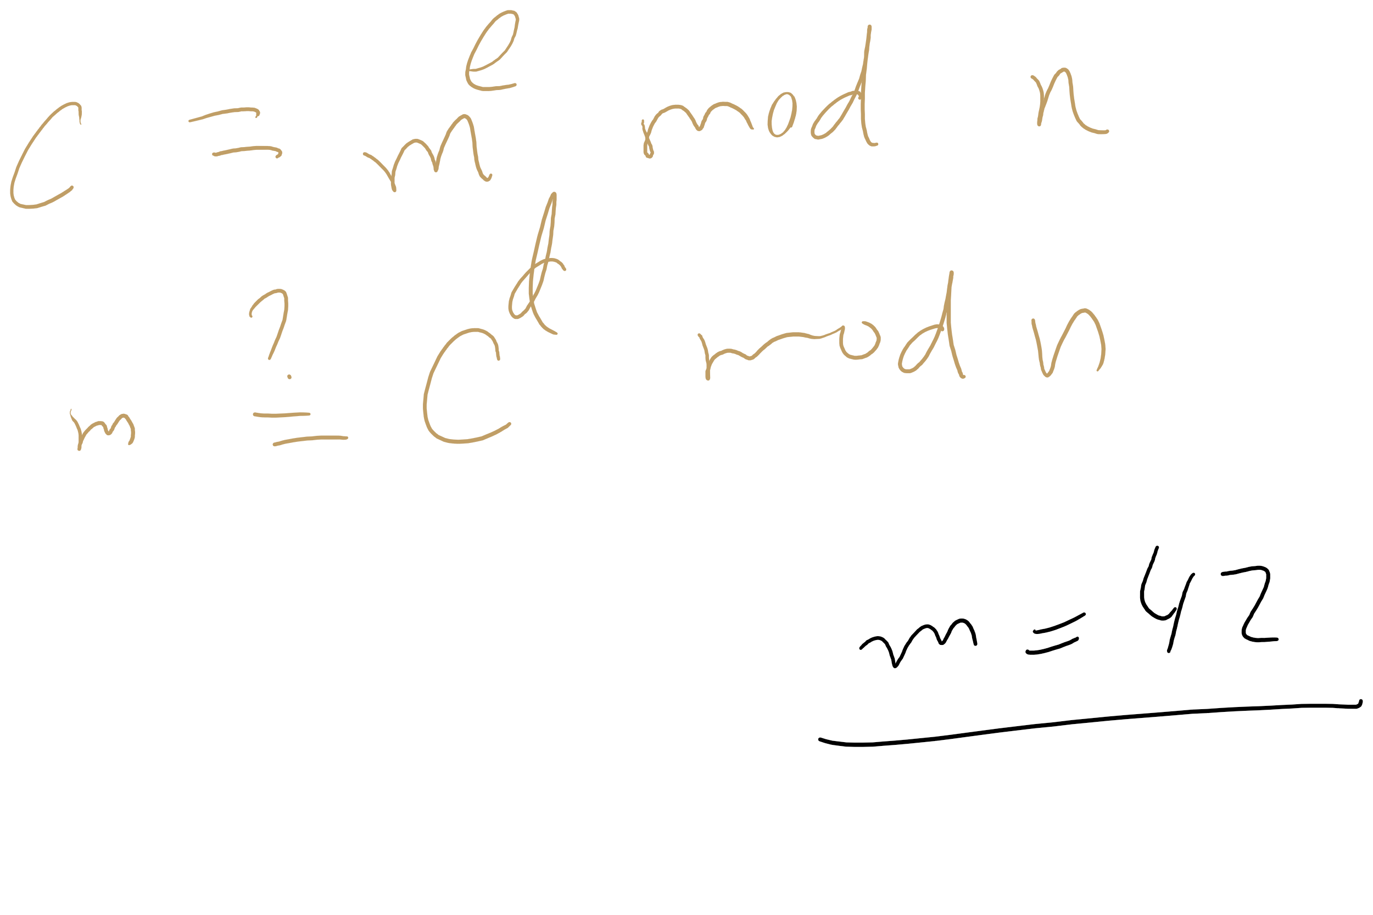
RSA Example 1

Slide 17
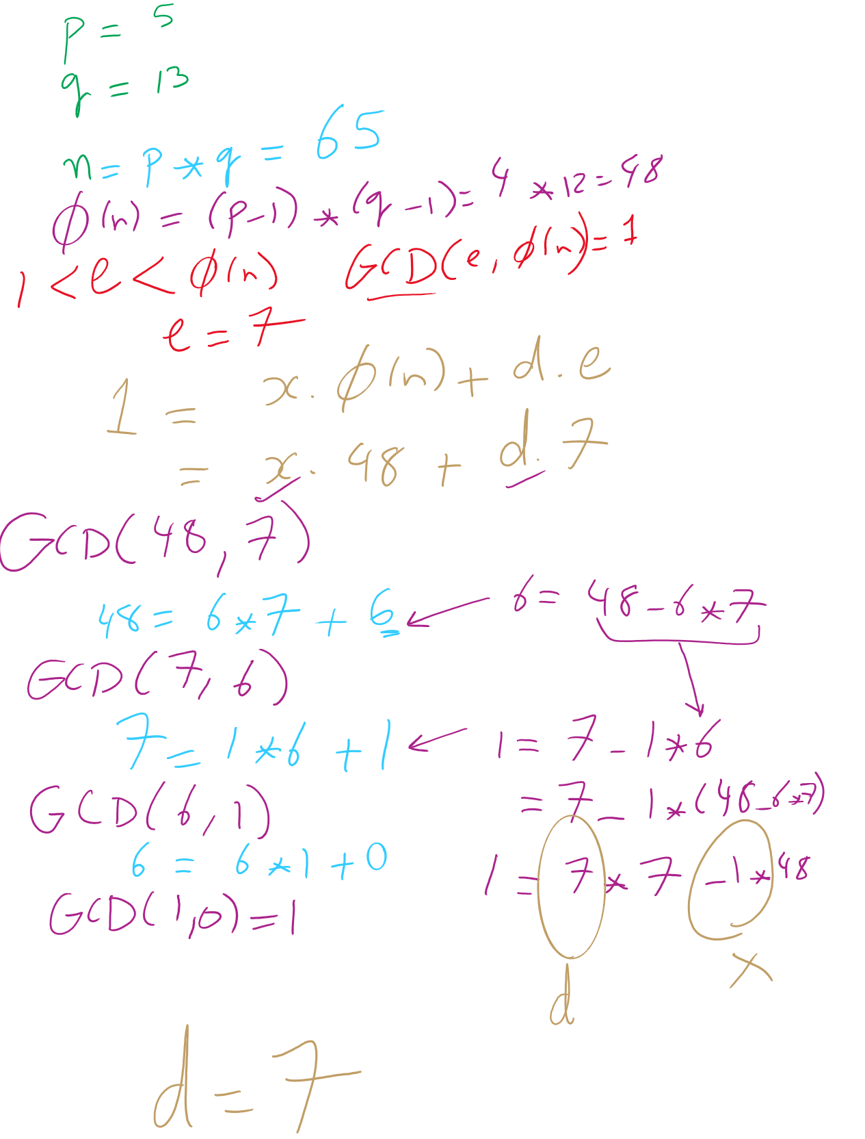
RSA Example 2

Slide 18
RSA Example 2

Slide 19
Why is RSA secure?
4 avenues of attack on the math of RSA were identified in the original paper:
Factoring n to find p and q
Determining φ(n) without factoring n
Determining d without factoring n or learning φ(n)
Learning to take e^{th} roots modulo n

Slide 20
Basic approach of the proof
Reduction
Reduce an already known hard problem to the attack
Reductions means:
Write an algorithm for the already known hard problem using the attack
Every other step is easy (i.e., done in polynomial time)
If the attack were easy, the already known hard problem would have also been easy
But it is known to be hard, so …?

Slide 21
Factoring n
To the best of our knowledge, this is hard
A 768 bit RSA key was factored one time using the best currently known algorithm
Took 1500 CPU years
2 years of real time on hundreds of computers
Hence, large keys are pretty safe
2048 bit keys are a pretty good bet for now

Slide 22
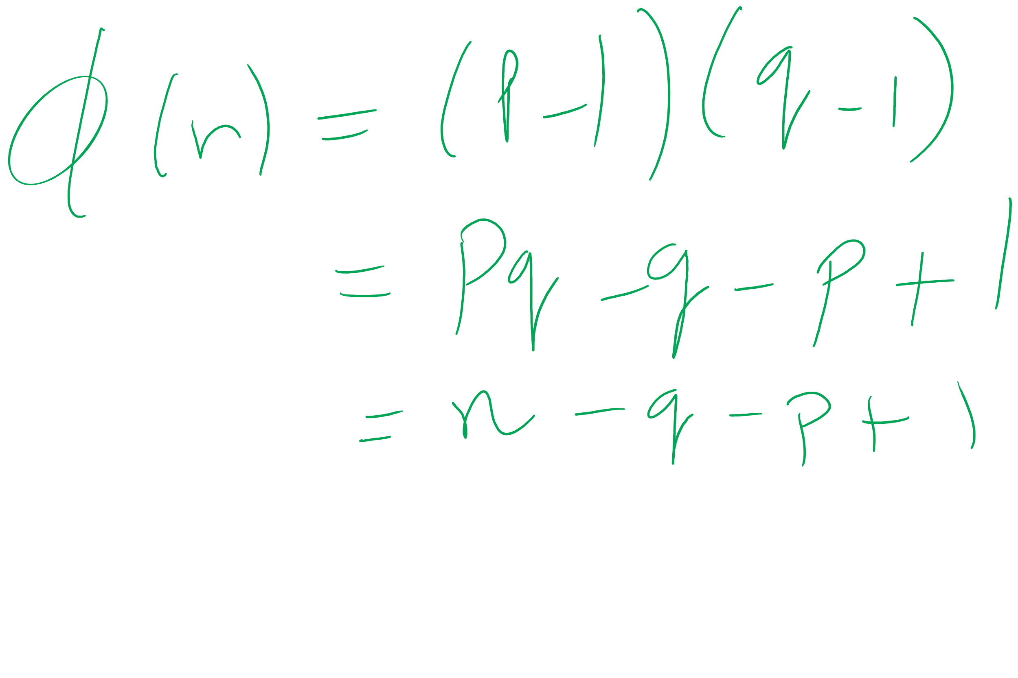
What about determining φ(n) without factoring n?
Would allow us to easily compute d because ed = 1 mod φ(n)
Note:
φ(n) = n - p - q + 1
φ(n) = n - (p + q) + 1
(p + q) = n + 1- φ(n)
(p + q) - (p - q) = 2q
Now we just need (p - q)...
(p - q)² = p² - 2pq + q²
(p - q)² = p² + 2pq + q² - 4pq
(p - q)² = (p + q)² - 4pq
(p - q)² = (p + q)² - 4n
(p - q) = √((p + q)² - 4n)
If we can figure out φ(n) efficiently, we could factor n efficiently!

Slide 23
This all leads to the following conclusion
Odds are that breaking RSA efficiently implies that factoring can be done efficiently.
Since factoring is probably hard, RSA is probably safe to use.

Slide 24
Implementation concerns
Encryption/decryption:
How can we perform efficient exponentiations?
Key generation:
We can do multiplication, XGCD for large integers
What about finding large prime numbers?

Slide 25
Efficient exponentiation for RSA
Does this solve our problems?
ans = 1
foreach bit in y:
ans = (ans² mod n)
if bit == 1:
ans = (ans * x mod n)
ans = 1
foreach bit in y:
ans = ans²
if bit == 1:
ans = ans * x
How can we improve runtime for RSA exponentiations?
Don’t actually need x^{y}
Just need (x^{y} mod n)

Slide 26
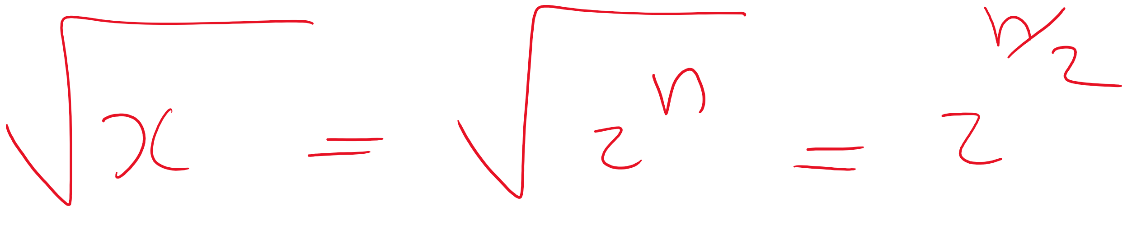
Prime testing option 1: BRUTE FORCE
Try all possible factors of x
1 .. sqrt(x)
aka 1 .. sqrt(2^{size(x)})
For a total of 2^{(size(x)/2)} factor checks
A factor check should take about the same amount of time as multiplication
size(x)²
So our runtime is Θ(2^{(size(x)/2)} * size(x)²)

Slide 27
Option 2: A probabilistic approach
Need a method test : Z×Z → {T, F}
If test(x, a) = F, x is composite based on the witness a
If test(x, a) = T, x is probably prime based on the witness a
To test a number x for primality:
Randomly choose a witness a
if test(x, a) = F, x is composite
if test(x, a) = T, loop
Possible implementations of test(x, a):
Miller-Rabin, Fermat’s, Solovay–Strassen
often probability ≈ 1/2
k repetitions leads to probability that x is composite ≈ 1/2^{k}

Slide 28


RSA Envelope example
KEY_{AES} = rand.nextInt(0, 2²⁵⁶)
KEY_{AES}
KEY_{AES}
SECRET MESSAGE
SECRET MESSAGE
BOB_{PUB}
BOB_{PRIV}
KEY_{AES}
BOB_{PUB}
KEY_{AES}

Slide 29
Now just sign a hash of the message!
H_{BOB} = h
MSG. DEF. FROM BOB
H_{ALICE} = h
MSG. DEF. FROM BOB
Same?
MSG. DEF. FROM BOB
MSG. DEF. FROM BOB
BOB_{PRIV}
BOB_{PUB}
H_{BOB}
BOB_{PRIV}
H_{BOB}

Slide 30
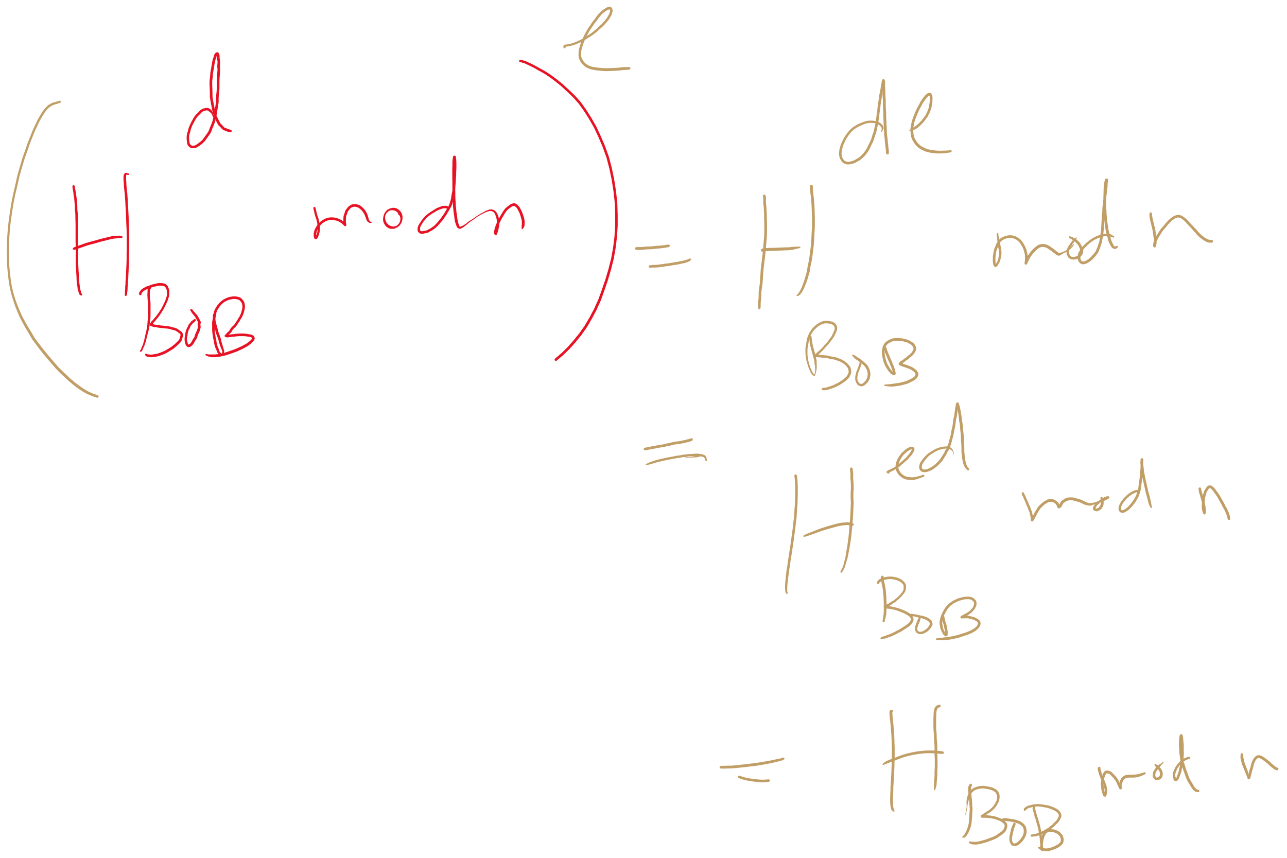
Why does it work?

Slide 31
Hashing for security
cryptographically secure hash functions must support certain properties:
It should be infeasible to find two different messages with the same hash value
It should be infeasible to recover a message from its hash
Should require a brute force approach
Small changes to a message should change the hash value so extensively that the new hash value appears uncorrelated with the old hash value

Slide 32
Public key isn’t perfect
What do you do when a private key is compromised?

Slide 33
Final note about crypto
NEVER IMPLEMENT YOUR OWN CRYPTO
Use a trusted and tested library.

Slide 34
Consider the change making problem
What is the minimum number of coins needed to make up a given value k?
If you were working as a cashier, what would your algorithm be to solve this problem?

Slide 35
This is a greedy algorithm
At each step, the algorithm makes the choice that seems to be best at the moment
Have we seen greedy algorithms already this term?
Yes!
Building Huffman trees
Nearest neighbor approach to travelling salesman

Slide 36
… But wait …
Nearest neighbor doesn't solve travelling salesman
Does not produce an optimal result
Does our change making algorithm solve the change making problem?
For US currency…
But what about a currency composed of pennies (1 cent), thrickels (3 cents), and fourters (4 cents)?
What denominations would it pick for k=6?

Slide 37
So what changed about the problem?
For greedy algorithms to produce optimal results, problems must have two properties:
Optimal substructure
Optimal solution to a subproblem leads to an optimal solution to the overall problem
The greedy choice property
Globally optimal solutions can be assembled from locally optimal choices
Why is optimal substructure not enough?
Notes:
Opt. substructure:
If we know the best way to make 3 cents, we can use that to find the best way to make 6 cents
Greedy choice:
When looking to make 6 cents, we know for US currency that the best overall choice will be to use the biggest coin (nickel)
With thrickels/fourters, we can't know until we've looked at all possible breakdowns
Note that this can be done recursively

Slide 38
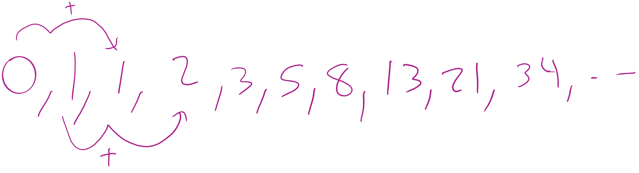
Finding all subproblems solutions can be inefficient
Consider computing the Fibonacci sequence:
int fib(n) { if (n == 0) { return 0 }; else if (n == 1) { return 1 }; else { return fib(n - 1) + fib(n - 2); } }
What does the call tree for n = 5 look like?

Slide 39
fib(5)
fib(5)
fib(4)
fib(3)
fib(4)
fib(3)
fib(3)
fib(3)
fib(2)
fib(2)
fib(2)
fib(1)
fib(2)
fib(1)
fib(2)
fib(2)
fib(1)
fib(1)
fib(1)
fib(1)
fib(0)
fib(0)
fib(1)
fib(0)
fib(1)
fib(0)
fib(1)
fib(1)
fib(0)
fib(0)
Notes:
How many times is fib(1) called?
What about n = 6?

Slide 40
How do we improve?
fib(5)
fib(4)
fib(3)
fib(3)
fib(2)
fib(2)
fib(1)
fib(2)
fib(1)
fib(1)
fib(0)
fib(1)
fib(0)
fib(1)
fib(0)
Notes:
Reuse generated results just like we did with Karatsuba's

Slide 41
Memoization
int[] F = new int[n+1]; F[0] = 0; F[1] = 1; for(int i = 2; i <= n; i++) { F[i] = -1 };
int dp_fib(x) { if (F[x] == -1) { F[x] = dp_fib(x-1) + dp_fib(x-2); } return F[x]; }

Slide 42
Note that we can also do this bottom-up
int bottomup_fib(n) {
if (n == 0)
return 0;
int[] F = new int[n+1];
F[0] = 0;
F[1] = 1;
for(int i = 2; i <= n; i++) {
F[i] = F[i-1] + F[i-2];
}
return F[n];
}
Notes:
THIS IS DYNAMIC PROGRAMMING

Slide 43
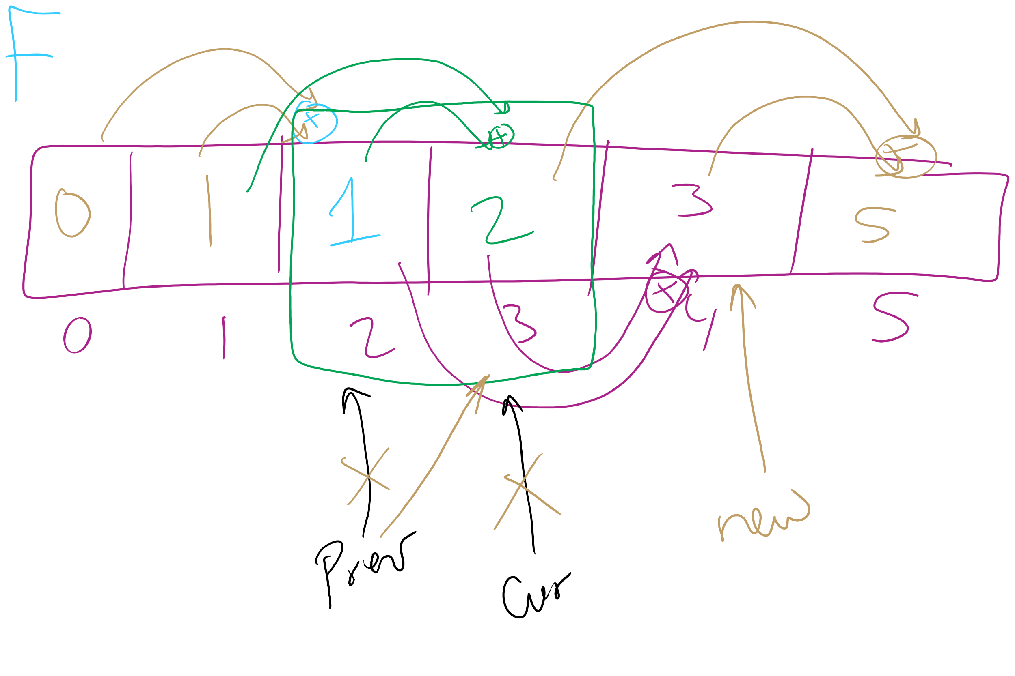
Can we improve this bottom-up approach?
int improve_bottomup_fib(n) {
int prev = 0;
int cur = 1;
int new;
for (int i = 0; i < n; i++) {
new = prev + cur;
prev = cur;
cur = new;
}
return cur;
}

Slide 44
Where can we apply dynamic programming?
To problems with two properties:
Optimal substructure
Optimal solution to a subproblem leads to an optimal solution to the overall problem
Overlapping subproblems
Naively, we would need to recompute the same subproblem multiple times
Notes:
Note that both problems amenable to DP and those amenable to greedy exhibit optimal substructure, the difference is if the greedy choice property exists or if overlapping subproblems

Slide 45
The unbounded knapsack problem
Given a knapsack that can hold a weight limit L, and a set of n types items that each has a weight (w_{i}) and value (v_{i}), what is the maximum value we can fit in the knapsack if we assume we have unbounded copies of each item?
Notes:
Start off asking how to solve problem (greedy or dp?)
Does it exhibit optimal substructure?
Does it exhibit greedy choice property?
Does it exhibit overlapping subproblems?

Slide 46



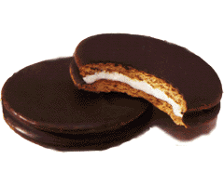

Recursive example
weight:
6
3
4
2
10 lb. capacity
value:
30
14
16
9
How much value in 10 lbs?
4 lbs?
8 lbs?
7 lbs?
6 lbs?
0?
2?
2?
6?
1?
5?
4?
1?
5?
0?
4?
4?
3?
3?
2?

Slide 47
Recursive example
weight:
6
3
4
2
10 lb. capacity
value:
30
14
16
9
How much value in 10 lbs?
4 lbs?
8 lbs?
7 lbs?
6 lbs?
0?
2?
2?
6?
1?
5?
4?
1?
5?
0?
4?
4?
3?
3?
2?

Slide 48
Bottom-up example
weight:
6
3
4
2
value:
30
14
16
9
Size:
0
1
2
3
4
5
6
7
8
9
10
Max val:
0
0
9
14
18
23
30
32
39
44
48
Notes:
Compute values to take max of on board

Slide 49
Please submit your reflections by using the CourseMIRROR App
If you are having a problem with CourseMIRROR, please send an email to coursemirror.development@gmail.com
Notes:
All right!
Upcoming Due Dates at A Glance

